Slide 1


The Fine Tuners
05.12.2023
Presented by Ecem Gunhar Akuras

Slide 2

Table of Content
Introduction and Steps of Evaluation
01
02
Evaluation of Irony
Evaluation of Sentiment Analysis
03
04
Evaluation of LLM Analysis
Evaluation of KPIs
05
06
Summary

Slide 3

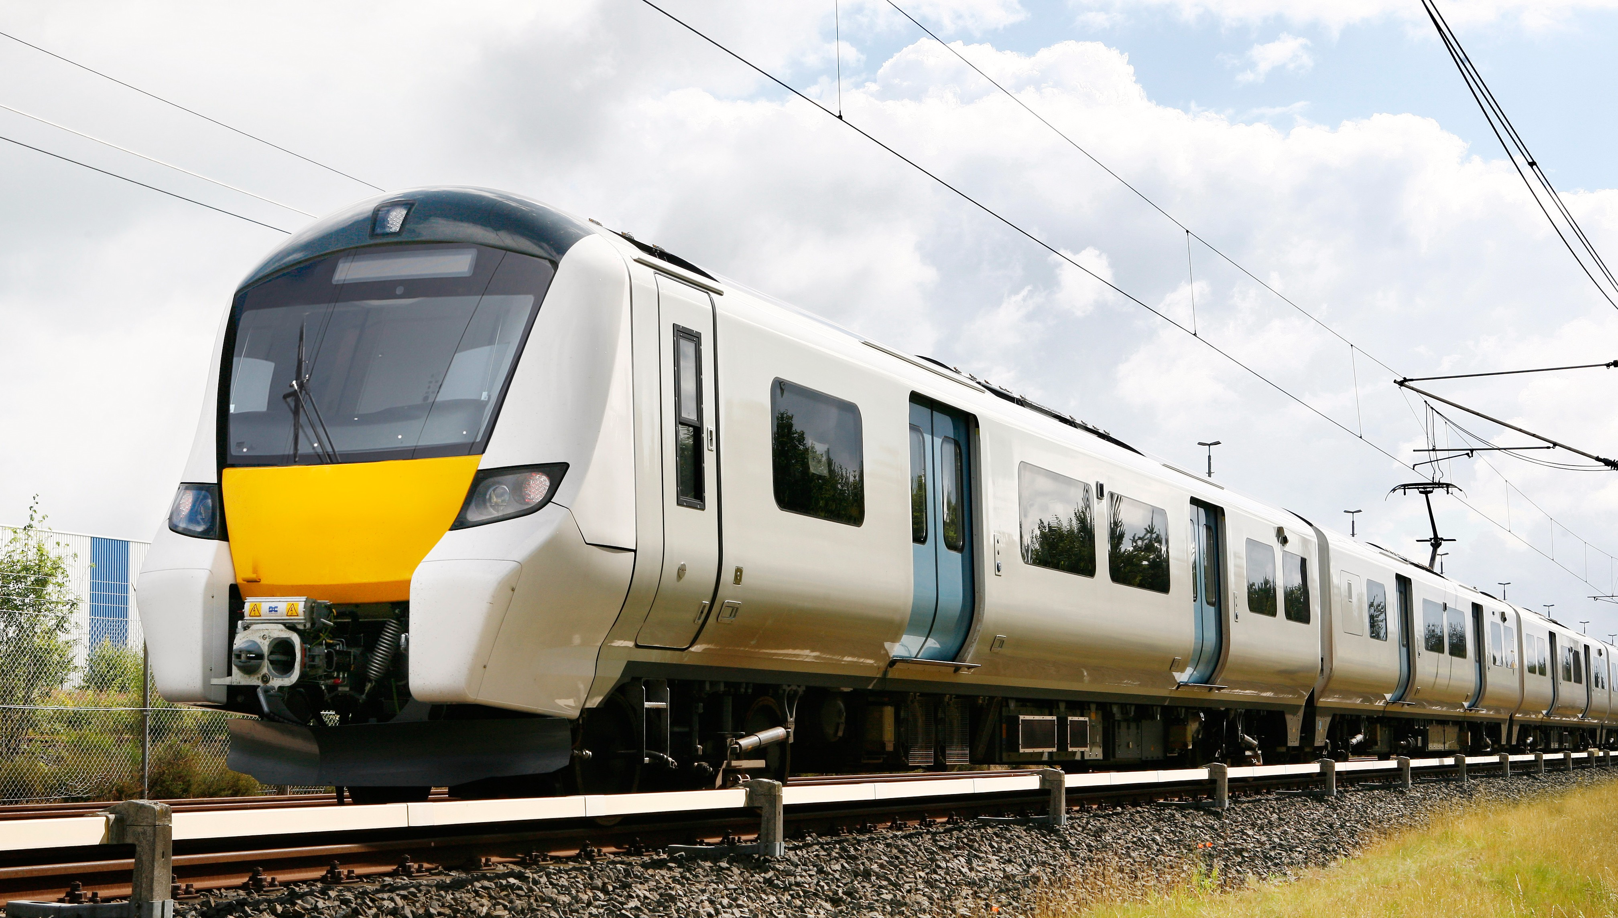
Introduction
Presentation Purpose : Evaluation of NLP Analysis Project to improve train maintenance.
Evaluation is our guide for improvement. It shows us what works well and where we can enhance, ensuring a better project.

Slide 4
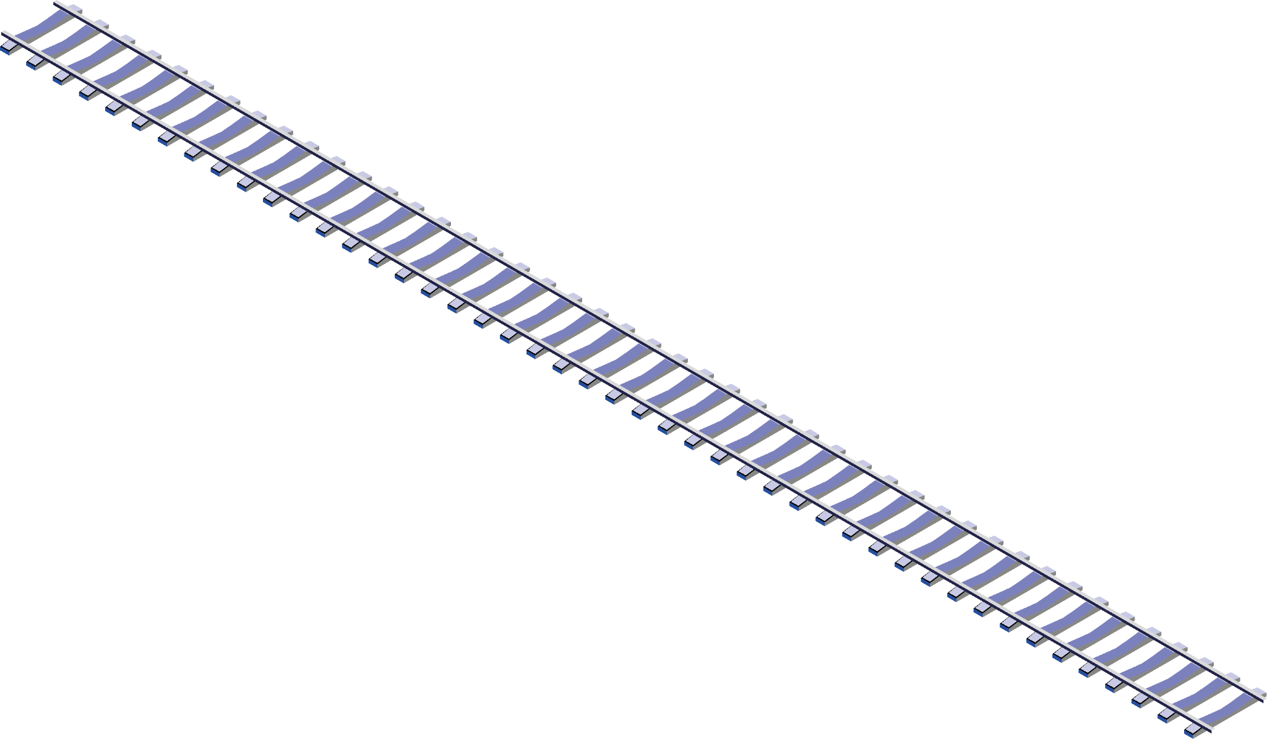
Evaluation of Irony
1
Evaluation of Sentiment Analysis
2
Evaluation of LLM Analysis
3
4
Evaluation of KPIs

Slide 5
Start
Label
Pre-Proccessing
Model
Label as Complaint or Not
Non-Ironic Tweets
Sentiment Analysis
Negative Sentiment
Positive or Neutral Sentiment
Tweets
Remove tweets from the operator
Remove tweets about delays
Irony Detection
Ironic Tweets
LLM Analysis
Label as Ironic or Not
Actionable
Insights

Slide 6
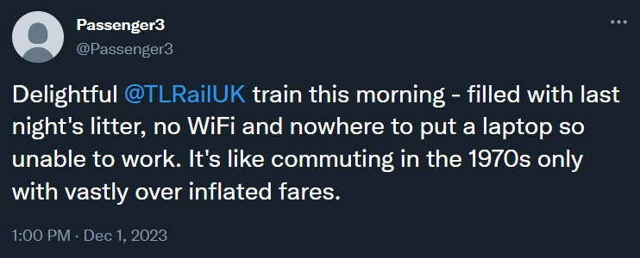
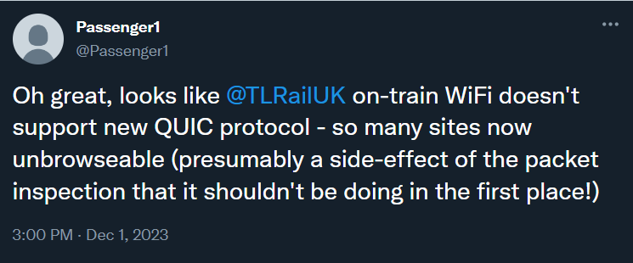
Evaluation of Irony
What is “irony”?
‘’The use of words that say the opposite of what you really mean, often as a joke.’’
Why is it important to identify ironic tweets?
Crucial for understanding true sentiment in passenger messages
Prevents misinterpretation for analysis of opinions
Enables a clear understanding for effective responses

Slide 7
Evaluation of Irony
Why do we use “Irony Detection”?
To mark ironic tweets and warn LLM Analysis.
How is irony detection evaluated?
Evaluated the model results by comparing them with insights from a user survey.
Survey includes 100 random tweets with two options: irony or not irony.
Survey results serve as the ground truth.
Model results are assessed using a confusion matrix.

Slide 8
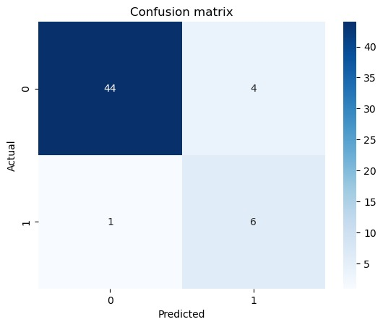
Evaluation of Irony
Confusion Matrix
Shows model`s accuracy and errors in the prediction.
Consists of 4 part as:
True Positives(TP) : The model found 6 instances of irony, matching the survey.
False Positives(FP): The model wrongly identified 4 instances of irony.
True Negatives (TN): The model correctly stated no irony in 44 instances.
False Negatives(FN): The model missed 1 instance of irony.

Slide 9
Evaluation of Irony
Non-Ironic Tweets
Sentiment Analysis
45 Tweets
100 Random Tweets
Remove tweets from the operator
Remove tweets about delays
Irony Detection
100 Tweets
95 Tweets
55 Tweets
Ironic Tweets
LLM Analysis
Label as Ironic or Not
10 Tweets

Slide 10
Evaluation of Irony
Evaluation Scores of Irony
Precision: 60%
When the model predicts a positive instance, it is correct 60% of the time.
Recall: 85.7%
This indicates that the model captures about 85.7% of all actual positive instances.
Specificity: 91.7%
Means that the model is accurate in predicting negative instances around 91.7% of the time.
Accuracy: 90.9%
Indicates that the model is correct in its predictions about 90.9% of the time.
F1 score: 70.6%
Provides a balanced measure of both precision and recall, giving an overall indication of the model's performance.

Slide 11
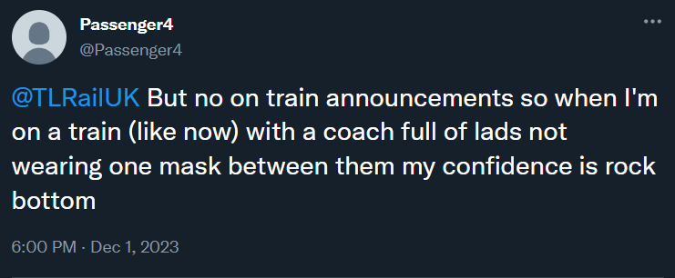
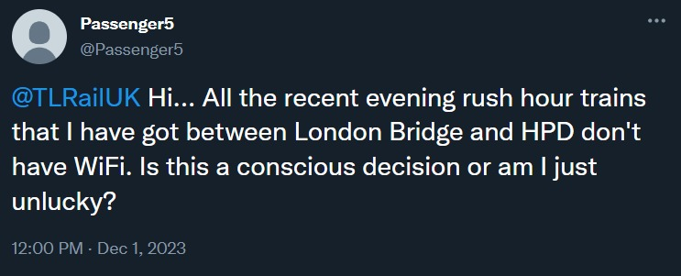
Evaluation of Sentiment Analysis
What is “negative sentiment”?
Negative sentiment refers to a generally pessimistic, critical or dissatisfied viewpoint.
Why is it important to identify negative sentiment in tweets?
Important to identify potential problems to enable early detection.
Helps to increase customer satisfaction.
Maintains a positive situation by preventing problems from escalating.
Notes:
Sentiment refers to the expressed emotions or opinions in language

Slide 12
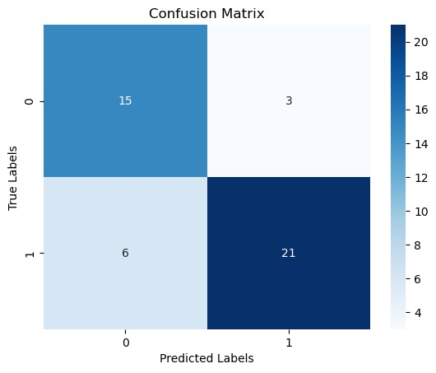
Evaluation of Sentiment Analysis
True Positives(TP) : The model found 21 instances of negative sentiment, matching the survey.
False Positives(FP): The model wrongly identified 3 instances of negative sentiment.
True Negatives (TN): The model correctly stated positive or neutral sentiment in 15 instances.
False Negatives(FN): The model missed 6 instance of negative sentiment.
Confusion Matrix of Evaluation of Sentiment

Slide 13
Evaluation of Sentiment Analysis
Label as Complaint or Not
Non-Ironic Tweets
45 Tweets
Sentiment Analysis
Remove tweets from the operator
Remove tweets about delays
Irony Detection
Negative Sentiment
Positive or Neutral Sentiment
100 Random Tweets
24 Tweets
100 Tweets
95 Tweets
55 Tweets
55 Tweets
Ironic Tweets
LLM Analysis
10 Tweets

Slide 14
Evaluation of Sentiment Analysis
Evaluation Scores of Sentiment
Precision: 71.4 %
The model is reliable when it predicts positive sentiment, with 71.4% of positive predictions being accurate.
Recall: 83.3%
The model correctly identified 83.3% of the actual negative tweets in the survey, indicating some missed positive tweets.
Specificity: 77.8%
The model is reasonably good at identifying non-negative sentiment, with 78.9% accuracy in these predictions.
Accuracy: 80.0%
Overall model accuracy is 80.0%, considering both positive and negative predictions.
F1 Score: 76.9%
The F1 score, a balance of precision and recall, is 76.9%, reflecting a good overall model performance.

Slide 15



Evaluation of LLM Analysis
Why do we use “LLM Analysis”?
To analyze passenger tweets for efficient categorization and resolution of train maintenance issues, including interpreting irony for accurate sentiment assessment.
Suggestion 1
LLM
Suggestion 2
How is “LLM Analysis” evaluated?
To evaluate the reliability of LLM Analysis by checking whether it provides similar output given the same input.

Slide 16
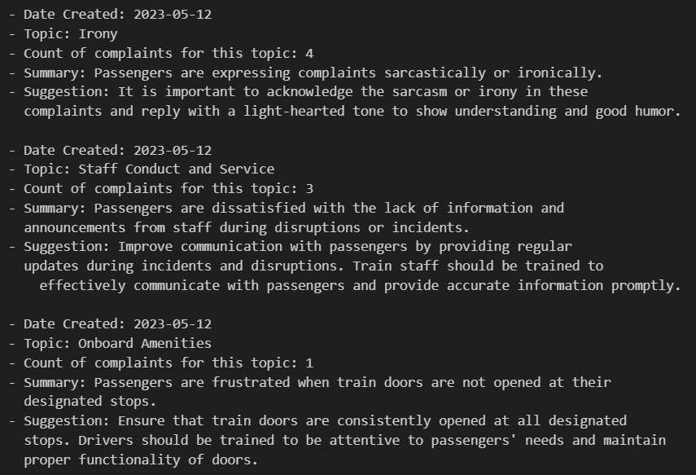
Evaluation of LLM Analysis
Does “LLM Analysis” works properly?
YES, because;
Consistent results in formatting
Categorised topics
Detailed suggestions for maintenance team
Handles irony
What are necessary reactions?
User feedback
Continuous improvement

Slide 17
Evaluation of KPIs
KPIs
Impact of Project
Resulting Effect
Our project streamlines the maintenance process.
Trains experience quicker issue resolution, leading to improved overall operational efficiency.
Operational Efficiency
Efficient issue resolution translates to cost savings.
The company benefits from reduced maintenance expenses.
Cost of Maintenance
Swift problem-solving enhances the reliability of train equipment.
Trains become more dependable, contributing to a reliable transportation service.
Equipment Reliability

Slide 18
Evaluation of KPIs
KPIs
Impact of Project
Resulting Effect
Timely maintenance ensures optimal safety.
Enhanced safety performance, reducing the risk of operational incidents.
Safety Performance
Swift identification and resolution of issues will affect the downtime of trains.
Significant decrease in train downtime, ensuring seamless service operations and improved customer satisfaction.
Downtime Reduction
Improved service quality and prompt issue resolution will affect the customer satisfaction.
Passengers experience better service, leading to higher customer satisfaction.
Customer Satisfaction

Slide 19
Summary
The Tweets2GPT project effectively detected irony and negative sentiment in passenger tweets and will contribute to the maintenance process of Thameslink trains.
LLM analysis will assist the maintenance team by organizing similar tweets and providing detailed recommendations.
To ensure continuous success, the project needs constant user feedback and constant improvement with new data.

Slide 20
Thank you!

